Slide 1
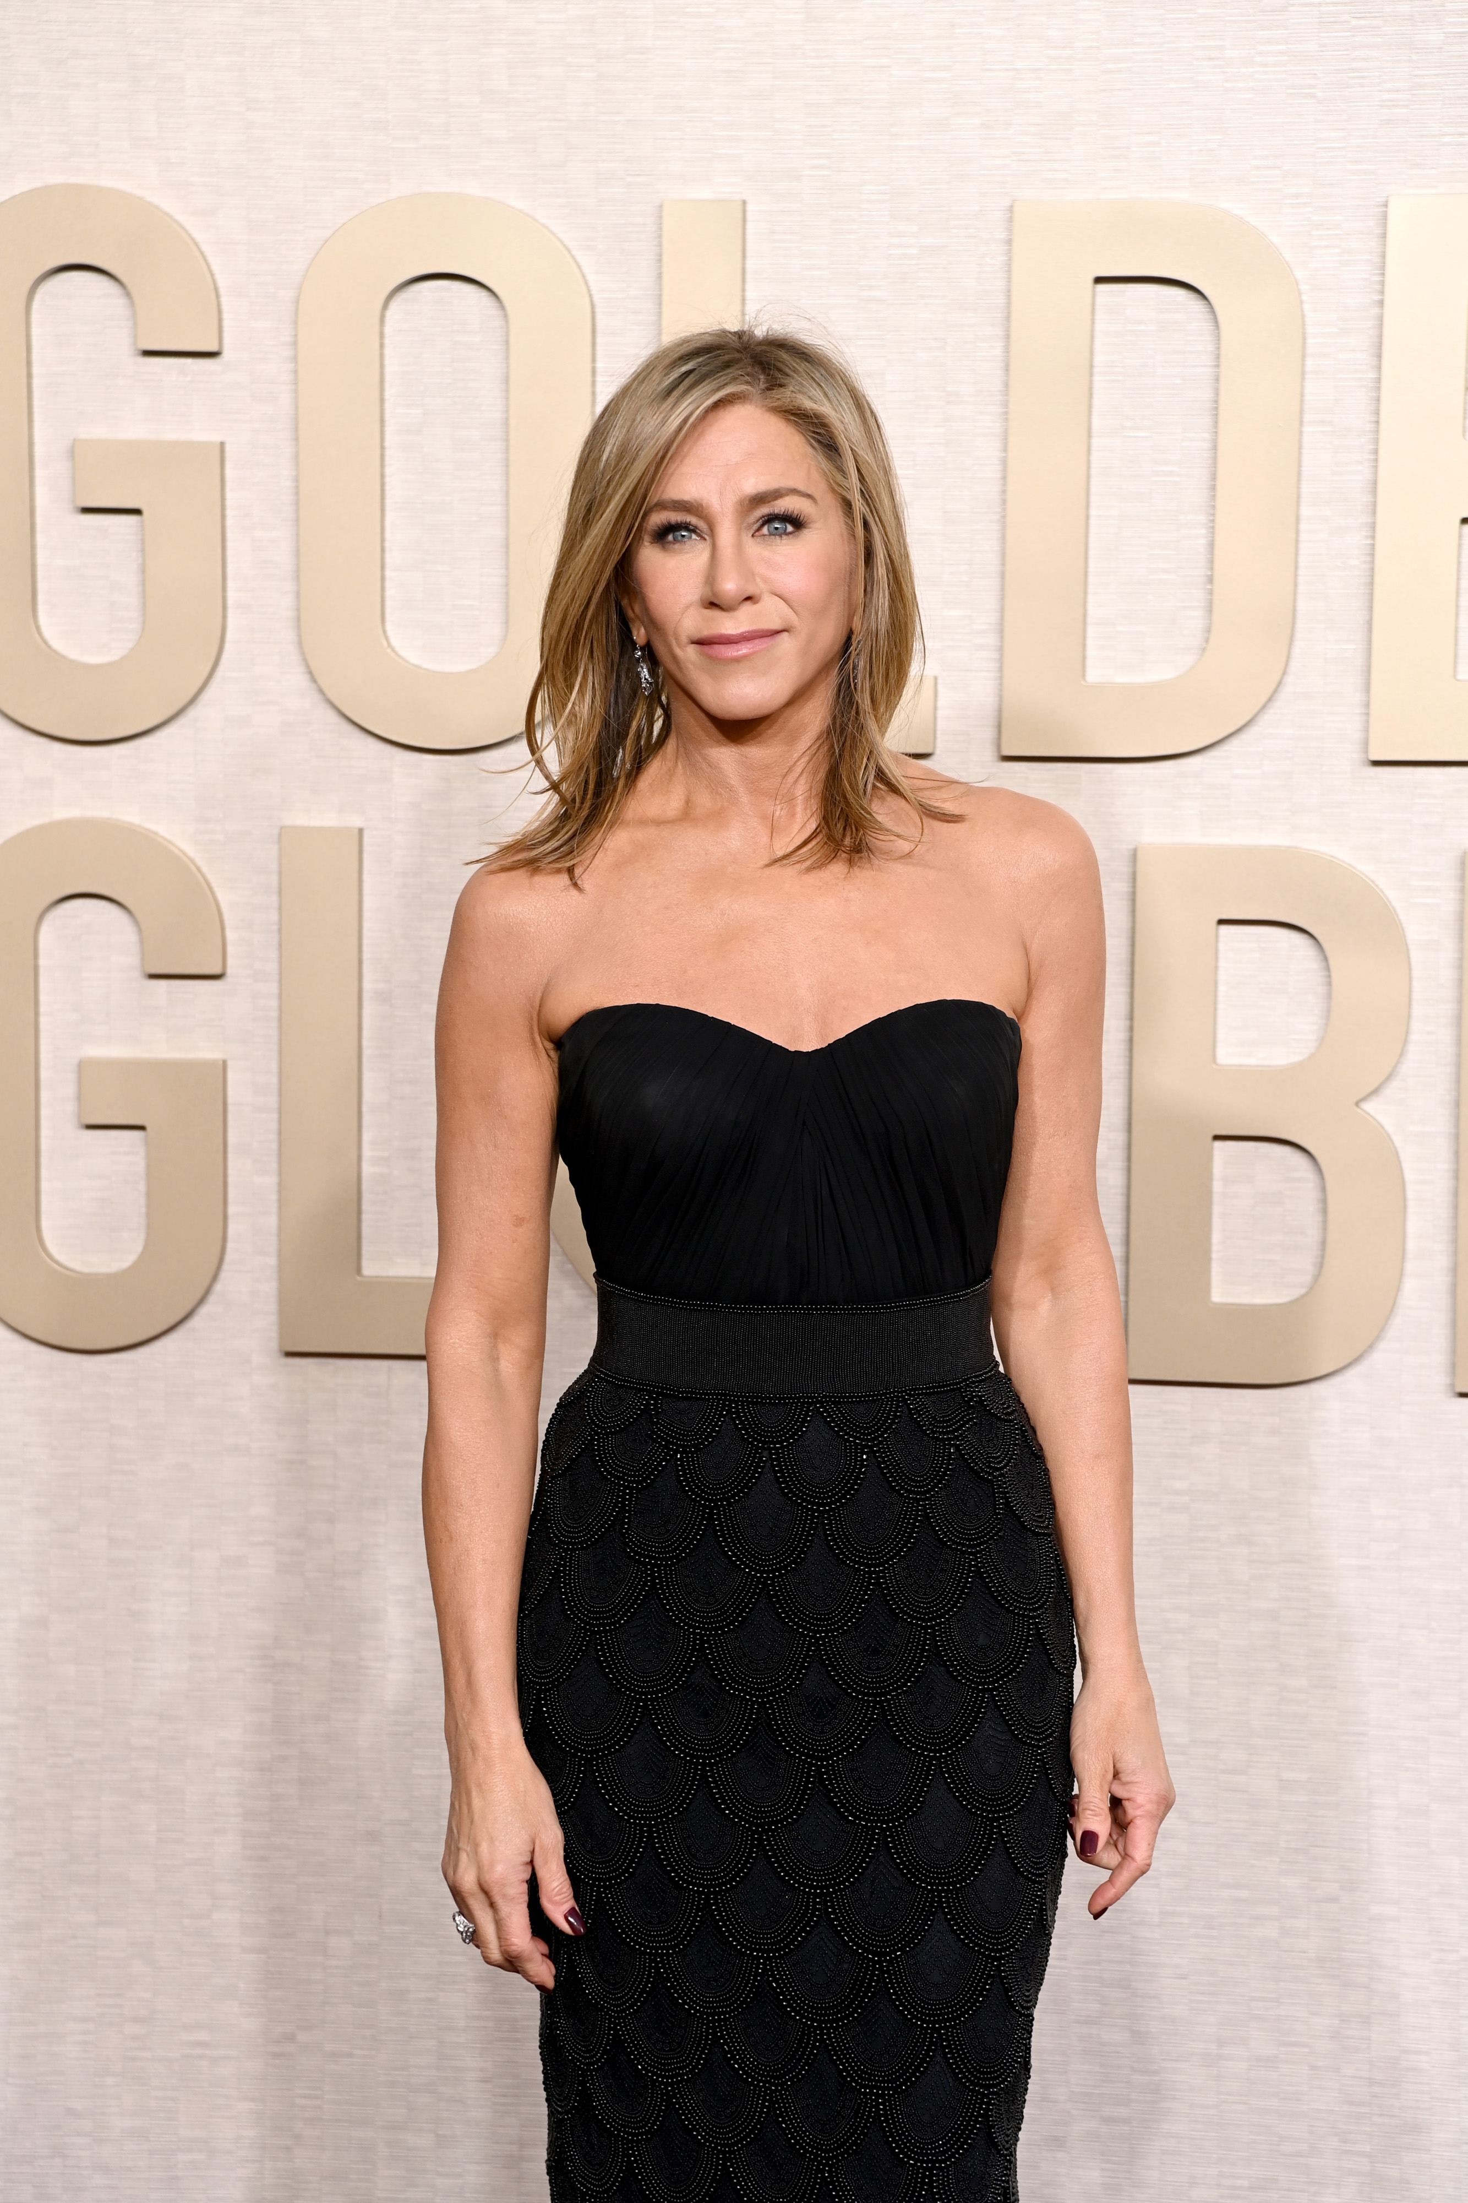
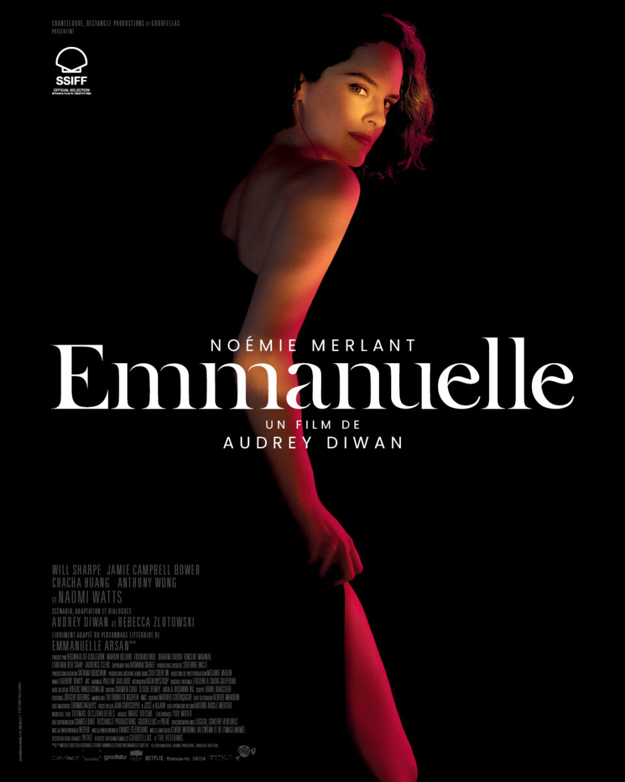
Key Figures
Jennifer Doudna, PhD
Emmanuelle Charpentier, PhD
Background: UC Berkeley biochemist; co‑discovered programmable CRISPR‑Cas9 genome editing (2012). Pioneered governance and ethical discourse for genome editing. 2020 Nobel Prize in Chemistry (with Emmanuelle Charpentier)
Quote: “This technology gives us a way to rewrite the code of life. With that power comes profound responsibility.”
Background: Microbiologist who identified tracrRNA and co‑invented the CRISPR‑Cas9 editing system. Founding and scientific leadership at the Max Planck Unit for the Science of Pathogens. 2020 Nobel Prize in Chemistry
Quote: “CRISPR is a simple concept with transformative implications when directed with precision and care.”

